Slide 1

ALY 6010 - 70864 Probability & Statistics Final Project Presentation CarDekho Sales Regression
By –
Akash Raj, Harshit Gaur & Varun Singh

Slide 2
Contents
Project Overview
Introduction
Data Cleaning & Feature Engineering
Exploratory Data Analysis (EDA)
Linear Regression
Conclusion

Slide 3


Project Overview
CarDekho.com is India's leading car search venture that helps users buy right cars for them.
Our focus was to learn and implement
Different types of statistics
Perform Uni-variate, Multi-variate Analyses
Understand the relationships between the attributes
Perform Hypothesis Testing
Ultimately build a Linear Regression Model.

Slide 4
Introduction
Features are related to
- Car details : Car name, transmission, fuel type, number of seats, year of manufacturing
- Engine details : Mileage, Engine type, Torque, Maximum power in BHP
- Sales details : Selling price, kilometers driven by the car
The data set contains data points of cars sold from 1983 to 2020.
We want to analyse this data set to help them expand their business, retain and gain customers, and stand out the competitions they face
The CarDekho data set has
- 8128 data points
- 13 features

Slide 5
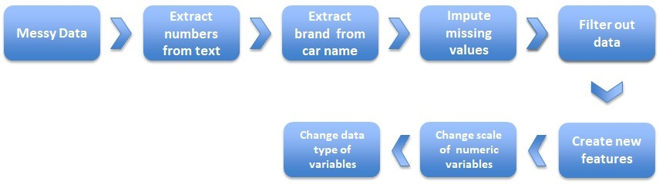
Data Cleaning & Feature Engineering
Data cleaning was done to get the data in the right format and obtain more information

Slide 6
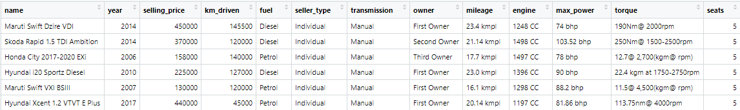
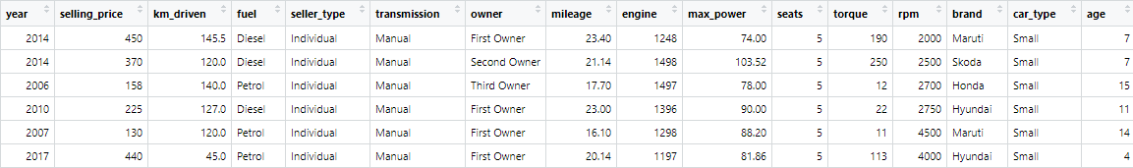
Data Cleaning & Feature Engineering
The numeric and the text fields were extracted from text fields like name, mileage, engine, max power, torque, etc.
New variables car type and age of car were created from the existing variables

Slide 7



Exploratory Data Analysis
Exploratory Data Analysis, or EDA refers to the initial investigation of the data to investigate patterns
Univariate Analysis includes descriptive statistics and univariate plots like histogram and box plot to understand the distribution of the data
Bivariate Analysis is used to determine empirical relationship between two variables using charts like scatter plot and pair plot
Based on the assumptions framed from the univariate and bivariate analysis, correlation and hypothesis testing is used to validate those assumptions
Univariate Analysis
Multivariate Analysis
Hypothesis Testing

Slide 8
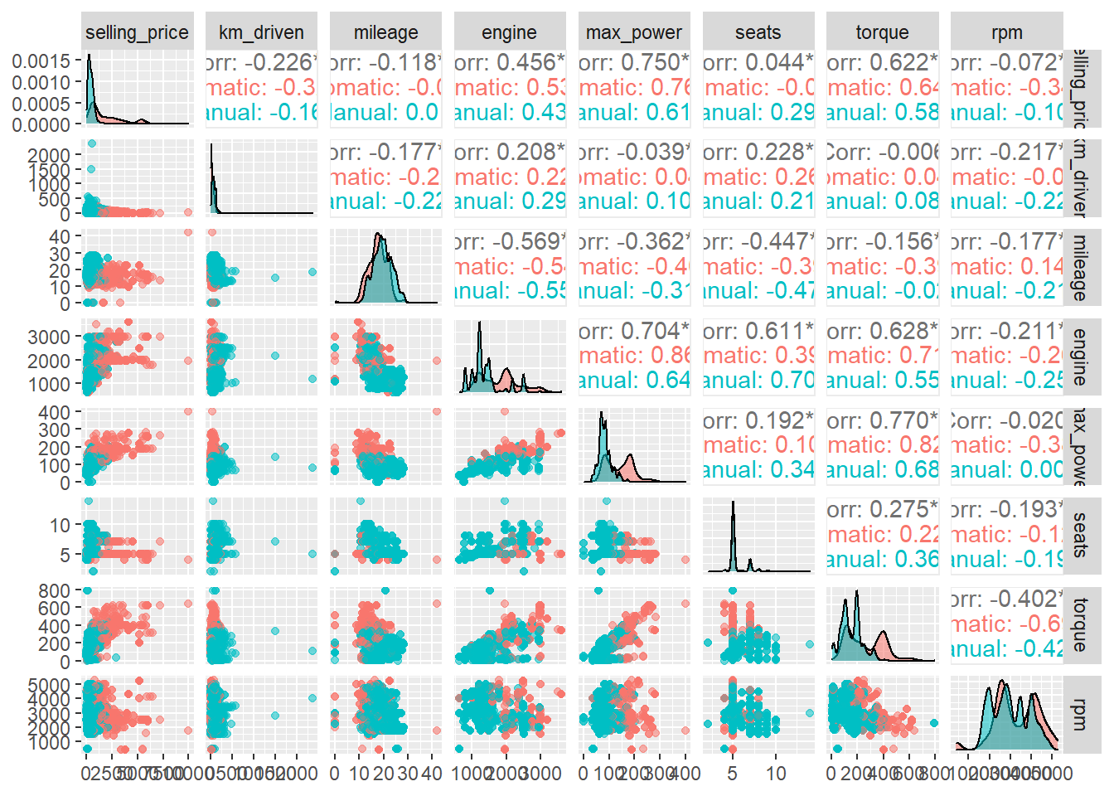
Exploratory Data Analysis
Distribution of data
Skewness and Outliers
Descriptive Statistics
Relationship between Variables

Slide 9
Exploratory Data Analysis

Slide 10
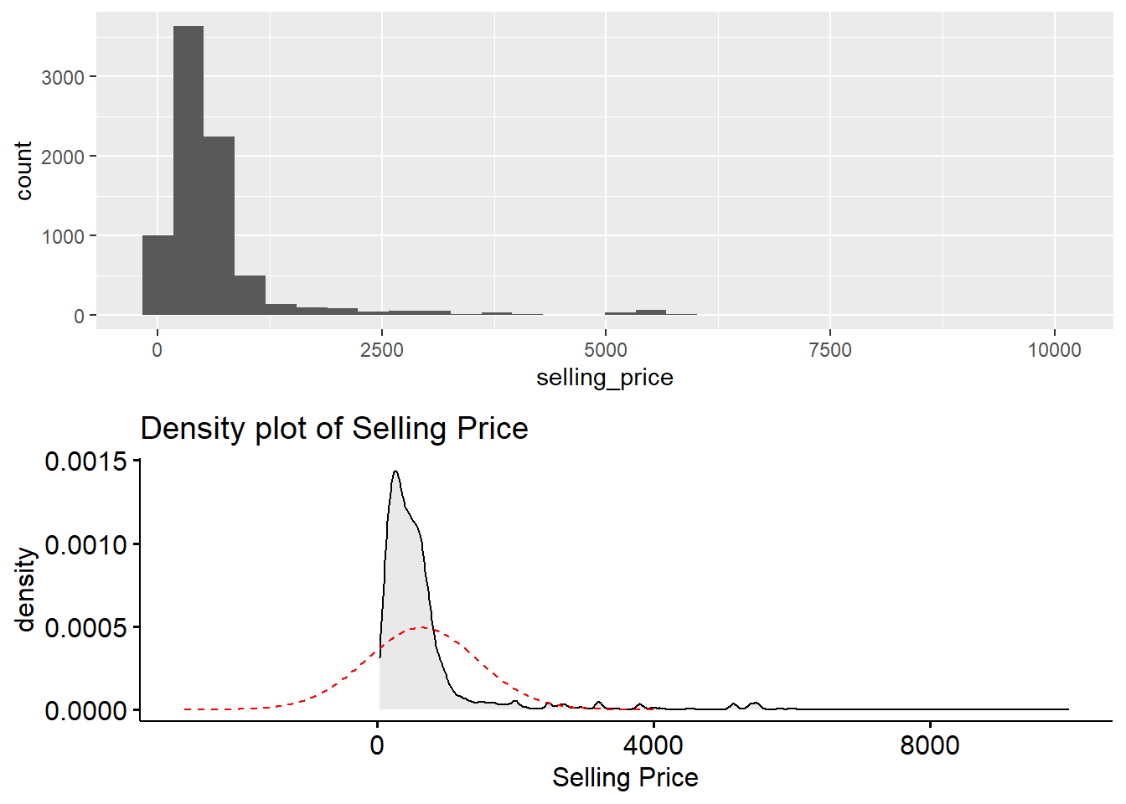
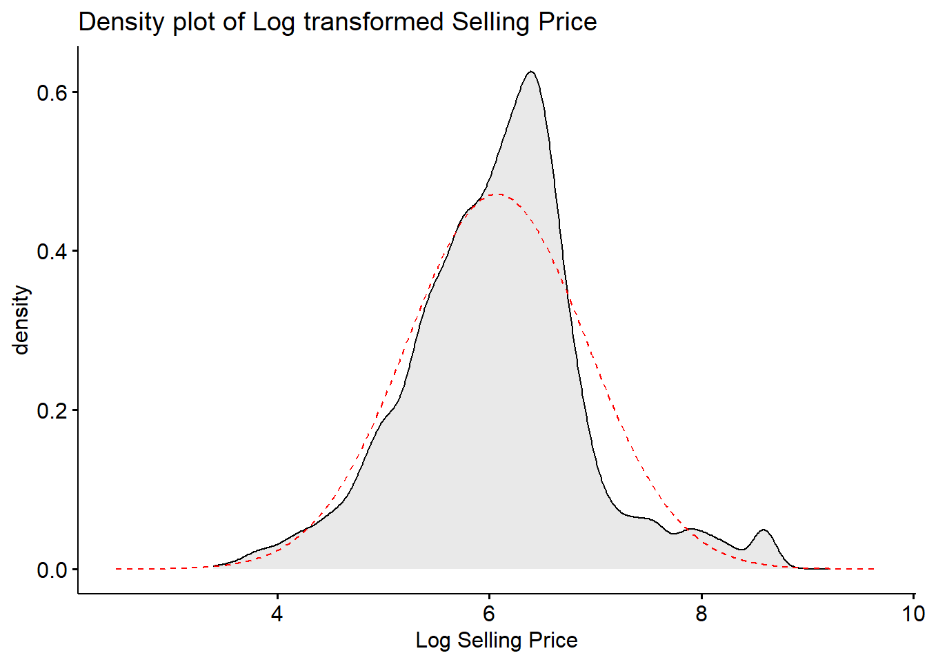

Linear Regression
Linear Regression is used to model the selling price variable with respect to other variables like - fuel, seller type, transmission, owner, engine, max power, age, and brand
Linearity and Normality assumptions were validated, and selling price was transformed
The linear regression model can explain 90.6% variance in the price variable.

Slide 11
Conclusion
The number of cars sold from 1983 till 2000 were very less and most of them were manual cars.
After 2005, the demand of automatic cars increased.
Linear Regression is a good choice to model the selling price variable as it is linearly depended on some of the other independent variables.
The Coefficient of Determination (r²) is around 91%, which means that 91% variance of price variable is explained by independent variables.

